Slide 1
Git Remotes: GitHub

Slide 2
Git remotes
Remote repositories are versions of your project that are hosted on the Internet or network somewhere.
Collaborating with others involves managing these remote repositories and pushing and pulling data to and from them when you need to share work.
Examples: GitHub, Gitlab, Bitbucket

Slide 3

AI-powered developer platform that allows developers to create, store, manage and share their code.
It provides the distributed version control of Git plus access control, bug tracking, software feature requests, task management, continuous integration, and wikis for every project.
It is the world's largest source code host.

Slide 4

Remote
Fetch/pull
Fetch/pull
Push
Push
Push
Fetch/pull
Local
computer

Slide 5
Schedule
10:00-12:30 – Git remotes (Github)
11:30-11:45- Break
12:30 – 13:30 – Lunch
13:30- 14:30 Collaboration
- Dealing with conflicts when working in the same project

Slide 6


Slide 7
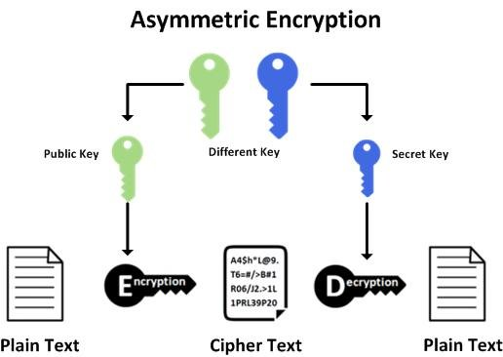
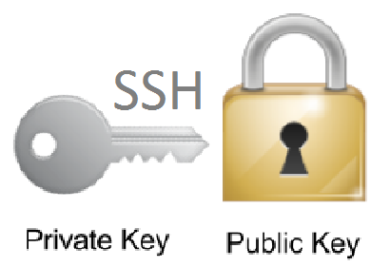
SSH connection
Secure Shell (SSH) is a cryptographic network protocol for operating network services securely over an unsecured network by providing a secure channel to connect an SSH client with an SSH server.

Slide 8



Dealing with conflicts when collaborating in a project
Remote
git add .
git commit –m “message”
git pull
git push
git add .
git commit –m “message”
git push
John
Alice

Slide 9
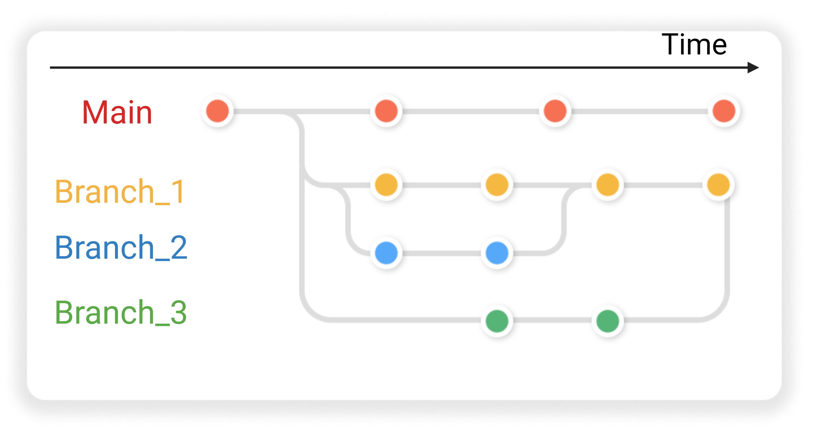

Slide 10
